Slide 1
Gun Permits in the US
Stacy Rodriguez, Anthony McNichols, Clayton Skinner, Jashad Tillmo and Paula Urteaga

Slide 2
Do states with more gun permits have higher crime rates?

Slide 3
The Experiment

Slide 4
Data
Number of permits data per state per month per year, from 1998 to 2018
Recorded gun crime incidents from 2013 to 2018, including date, place and number of casualties
Mass shooting data subset including casualties, date and location.

Slide 5
Hypothesis

Slide 6
Hypothesis support
I think this is what’s going to happen...
We think number of permits per state does correlate to higher gun related crimes
Variables that may affect the outcome...
Number of rechecked permits
Definition of crime
The dates when states approved the right-to-carry law

Slide 7



Data cleaning
From our incidents file, we extracted some useful information such as date, lat and long.
On our permits file, we have to modify and filter the date column in order to match the previous file’s dates
Sum up the number of permits of different types of guns to get the totals by state

Slide 8
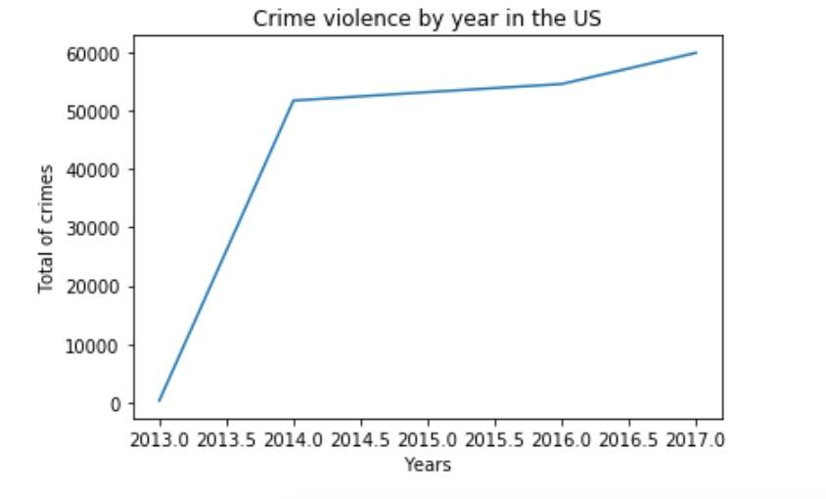
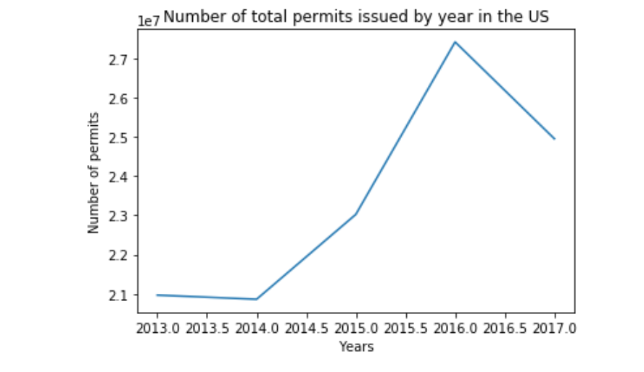
Notes:
Why couldn't we put the graphs together? There's a big discrepancy in numbers
What is it showing ?

Slide 9
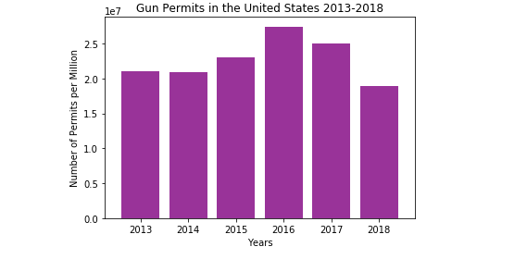
Gun Permits Per Year

Slide 10
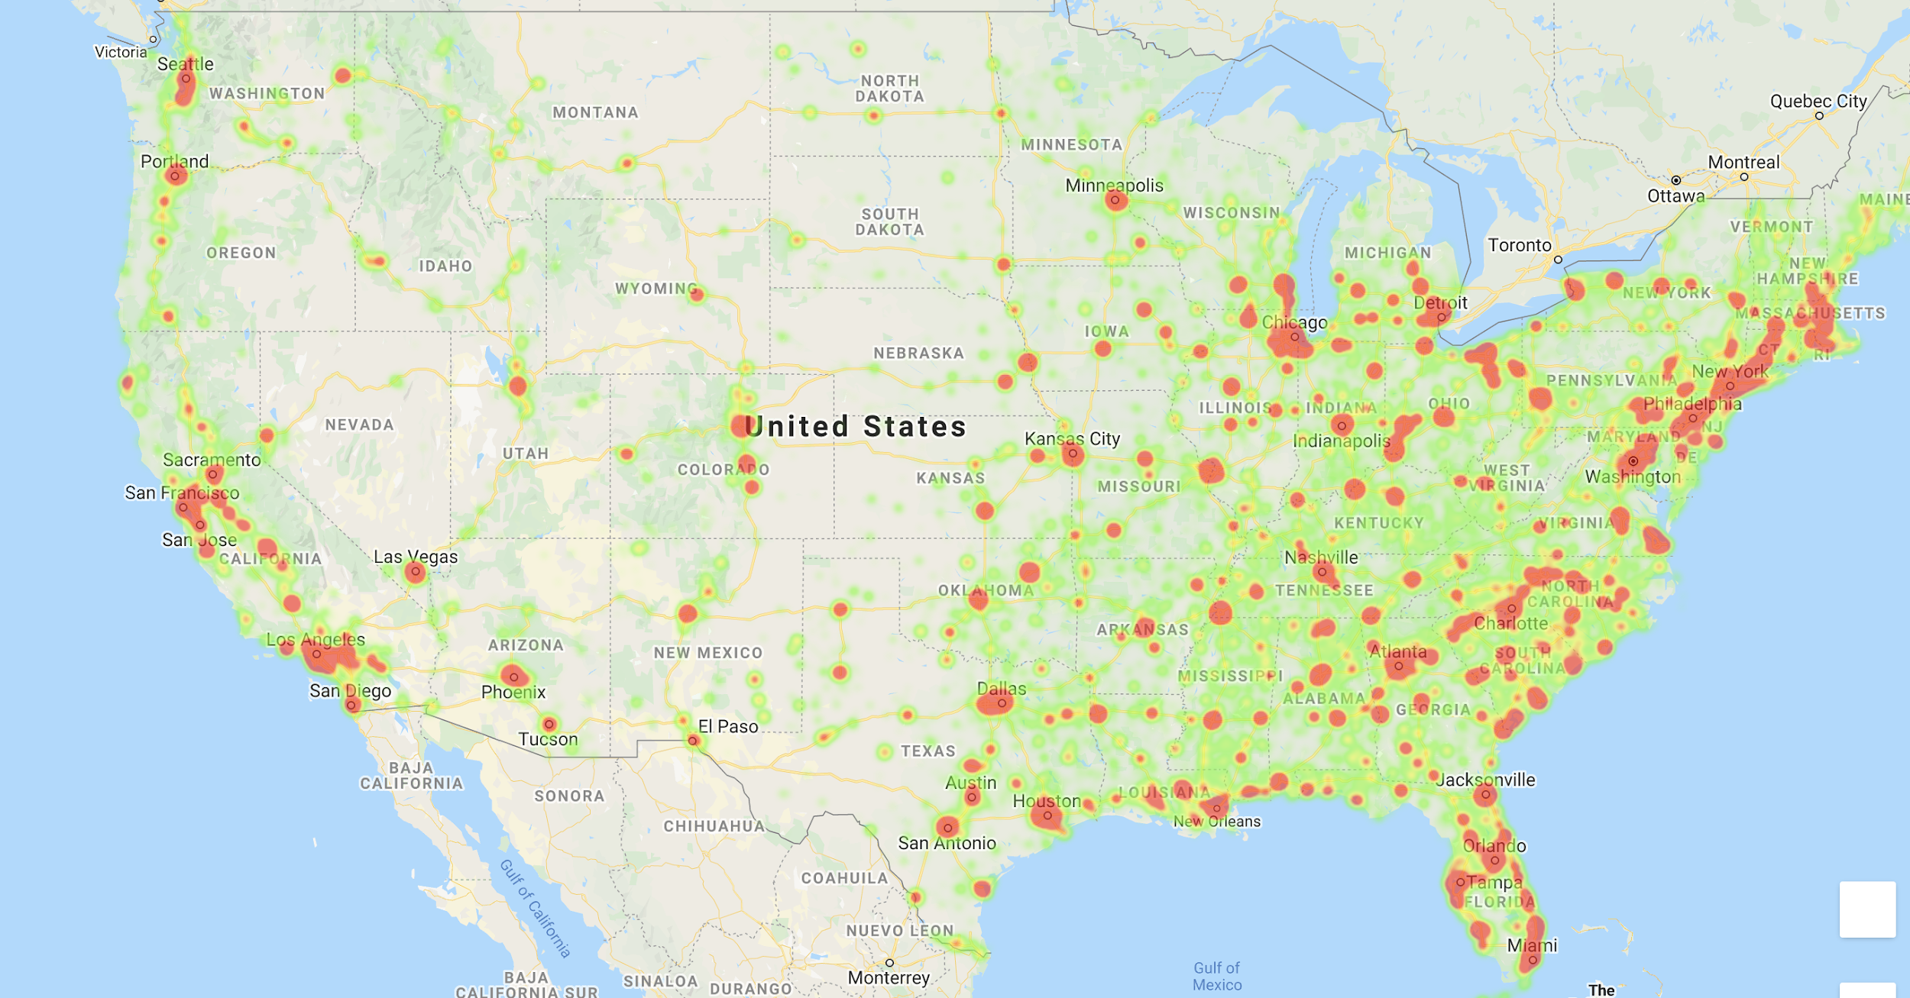
Crime data in the US
Notes:
Shown here is the geographical distribution of our data for gun crimes from 2013 to 2018. You can see that

Slide 11
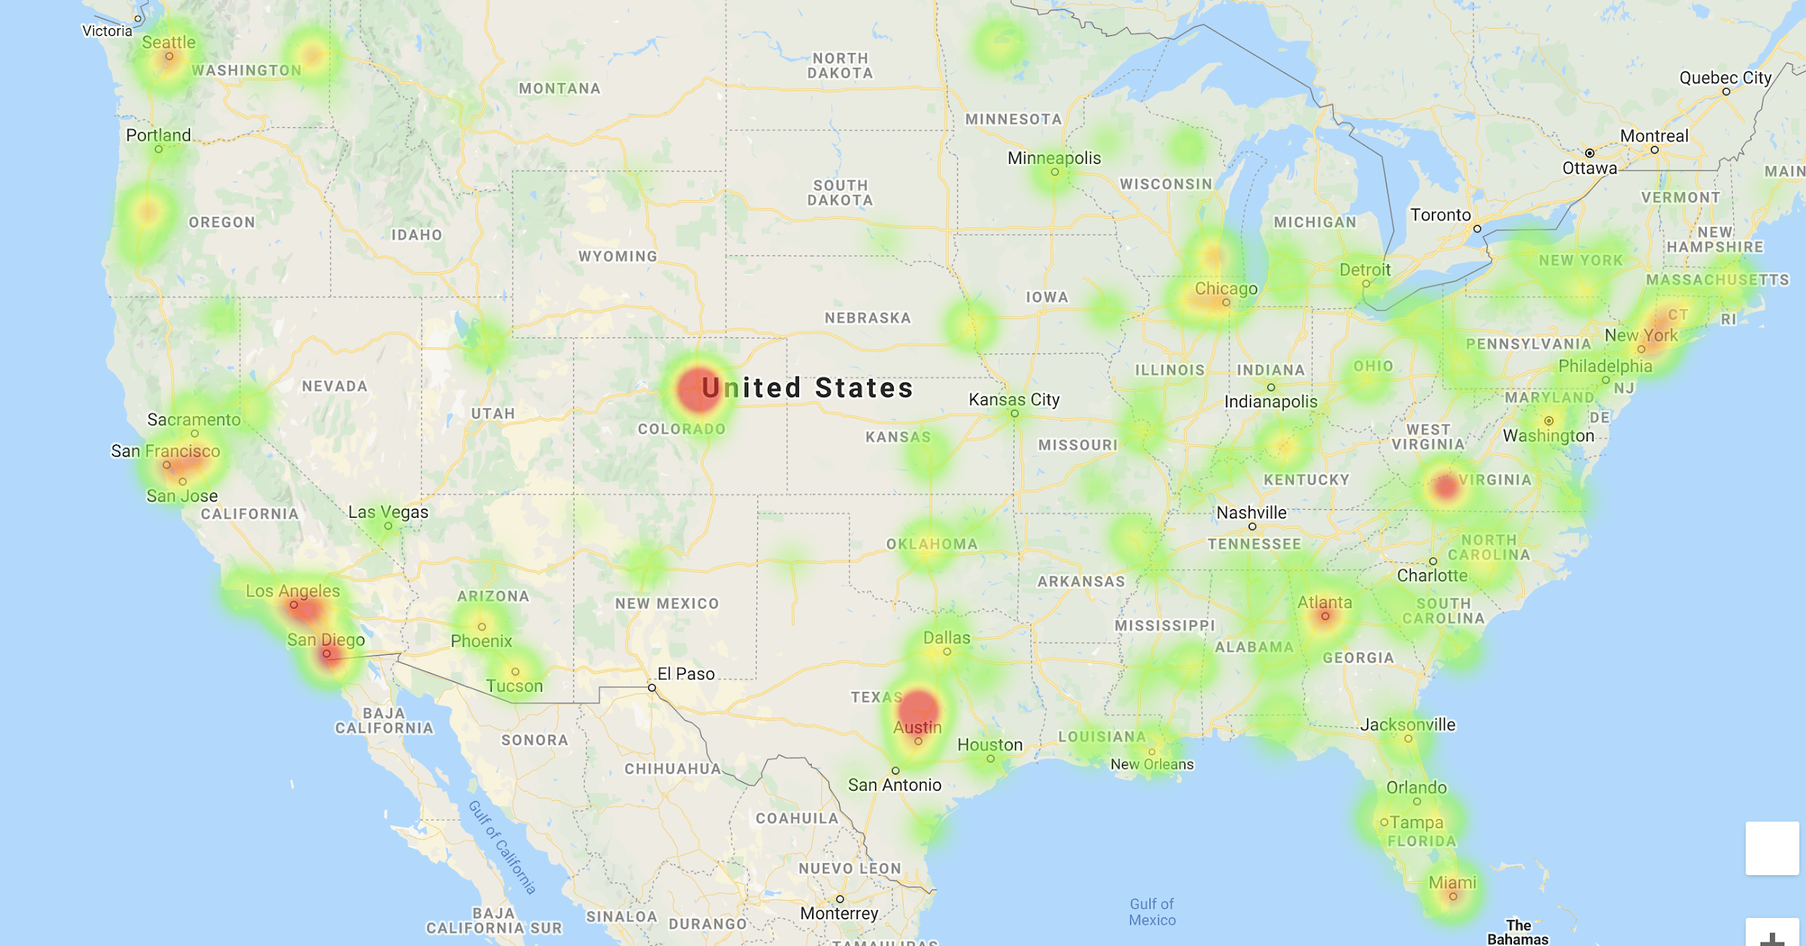
Mass shooting in the US
Notes:
Shows

Slide 12
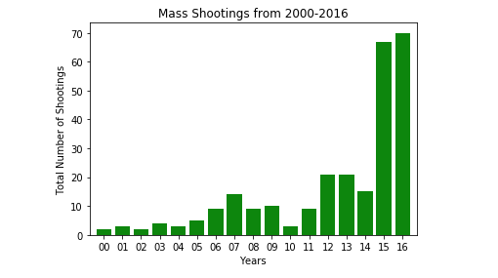
Mass Shootings in the United States

Slide 13
Conclusion
Lessons learned
No visible correlation between permits and gun crime
Permits more correlated to mass shootings, but other factors could contribute
Potential relation between location and number of incidents
Asking the right questions/ finding right data
Planning
Not enough data

Slide 14
Gun Permits in the US
Stacy Rodriguez, Anthony McNichols, Clayton Skinner, Jashad Tillmo and Paula Urteaga

